Slide 1

Presidential Session- Systematic Reviews of the Research on Emerging Online Technologies: What’s Been Done; What’s To Come
Meina Zhu
Curtis J. Bonk
Annisa Sari
Indiana University
School of Education, IST INDIANA UNIVERSITY BLOOMINGTON

Slide 2

MOOC Trends and Recent Data

Slide 3
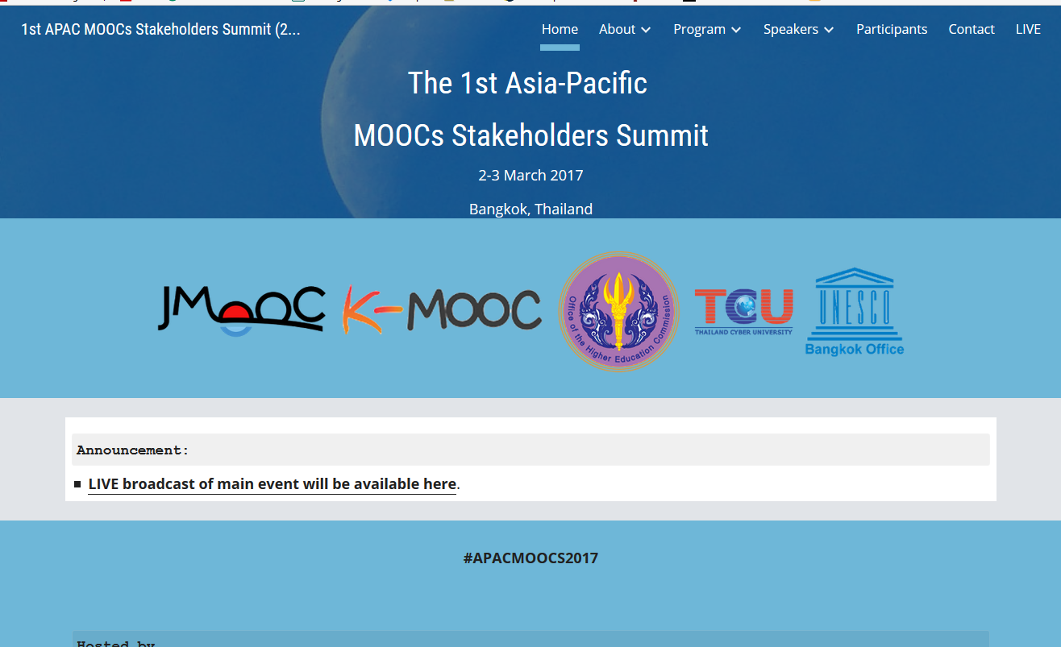



Weirdness #1…
June 15, 2017
Massive List of MOOC Providers Around The World, Class Central
JMOOC, K-MOOC, and T-MOOC? https://www.class-central.com/report/mooc-providers-list/

Slide 4

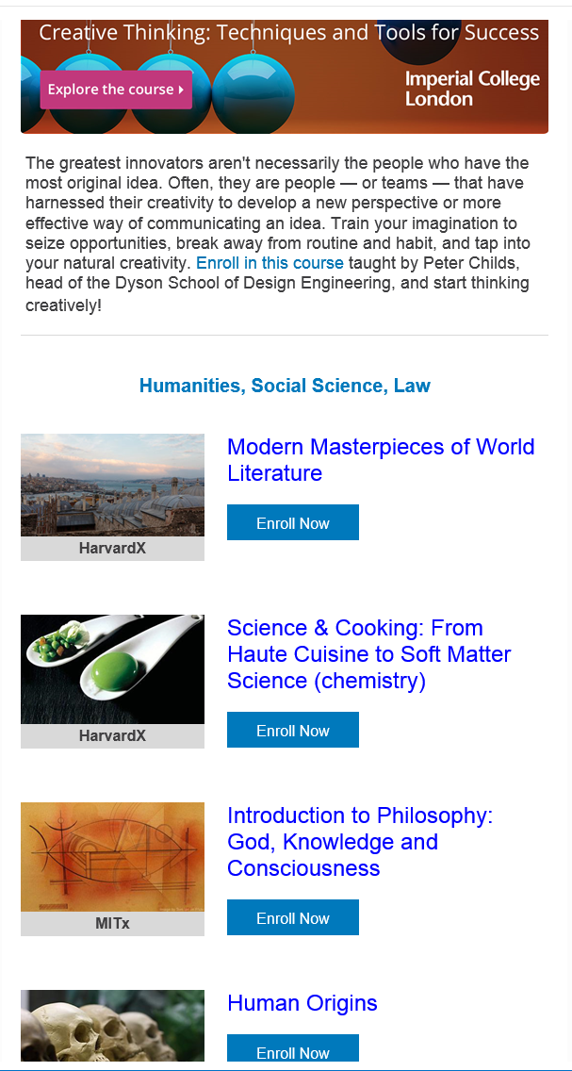


Weirdness #2…
Email inbox: June 10, 2018 edX (Summer discounts) https://www.edx.org/course

Slide 5

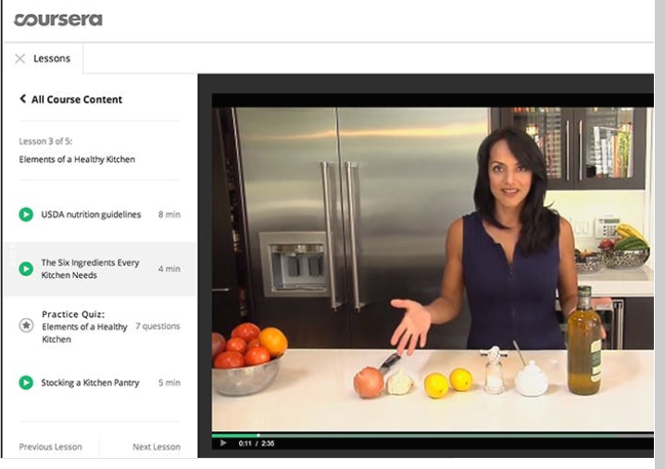
Weirdness #3…
Email inbox: June 11, 2018
Coursera https://www.coursera.org/

Slide 6



Weirdness #4…
September 26, 2018
The Future of Professional Credentialing ... in an Engagement Announcement
Joshua Kim, Inside Higher Ed https://www.insidehighered.com/digital-learning/blogs/technology-and-learning/future-professional-credentialing-engagement

Slide 7
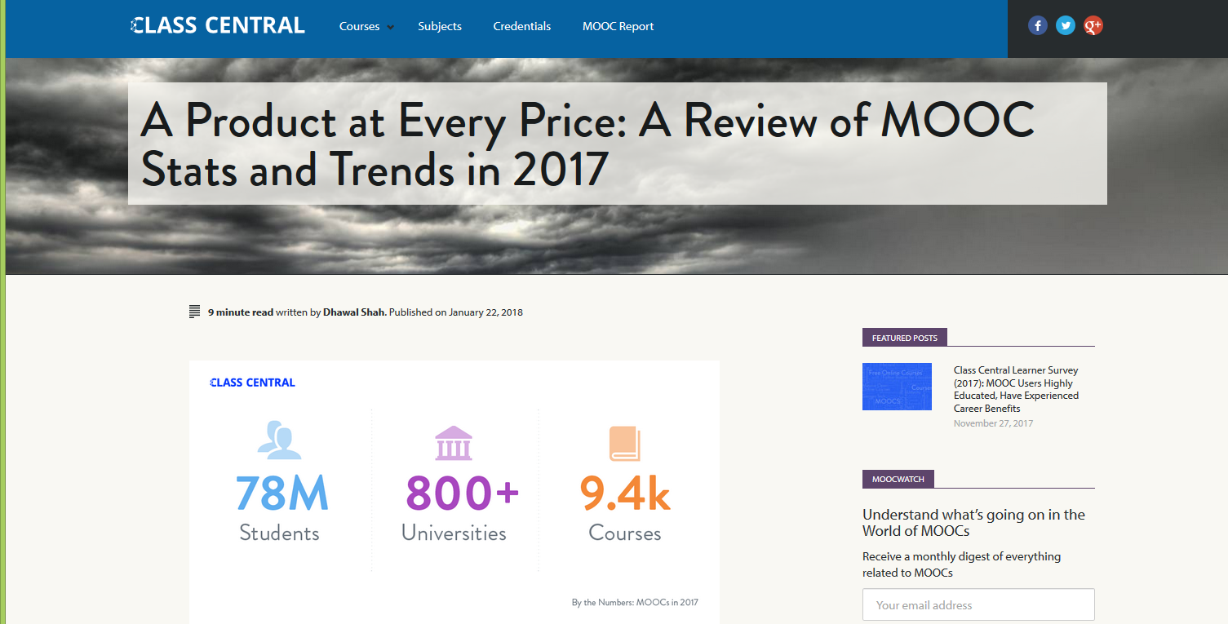
Weirdness #5…
January 22, 2018
A Review of MOOCs Stats and Trends in 2017, Dhawal Shah, Class Central https://www.class-central.com/report/moocs-stats-and-trends-2017/

Slide 8

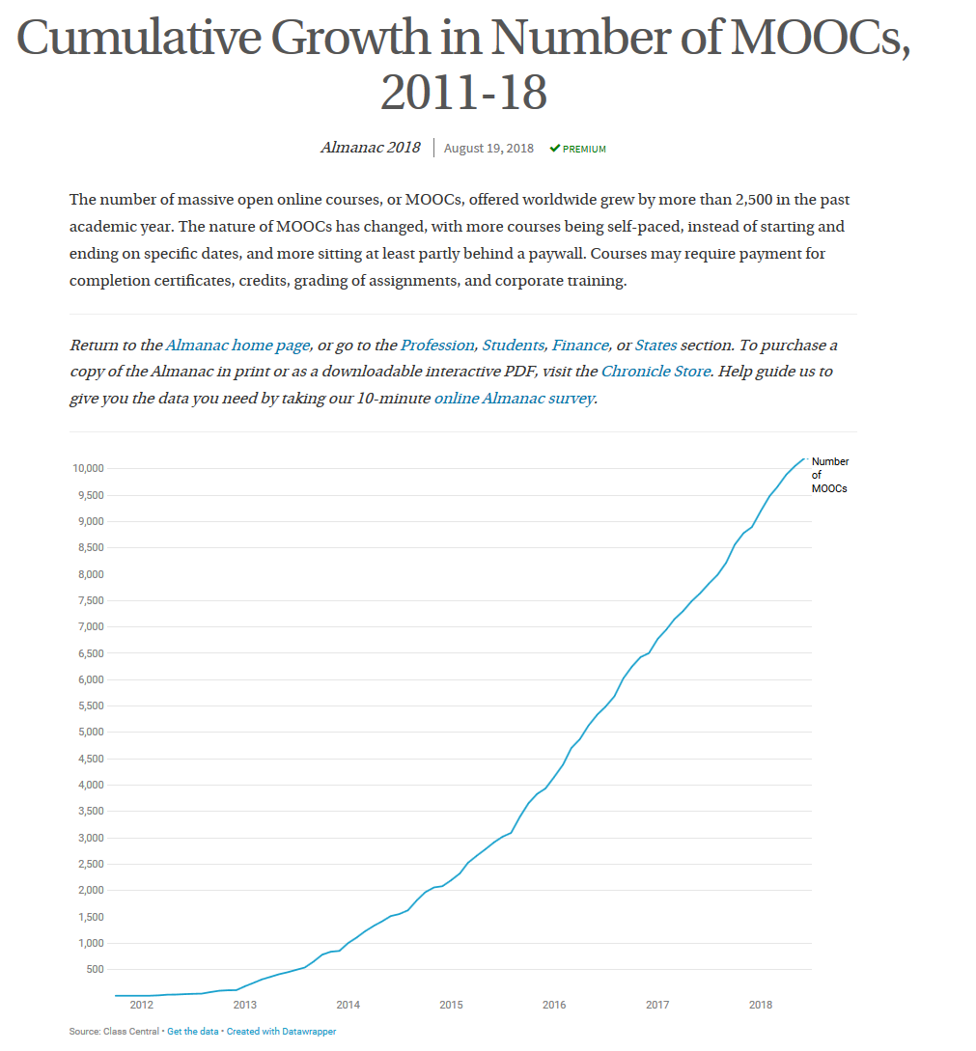
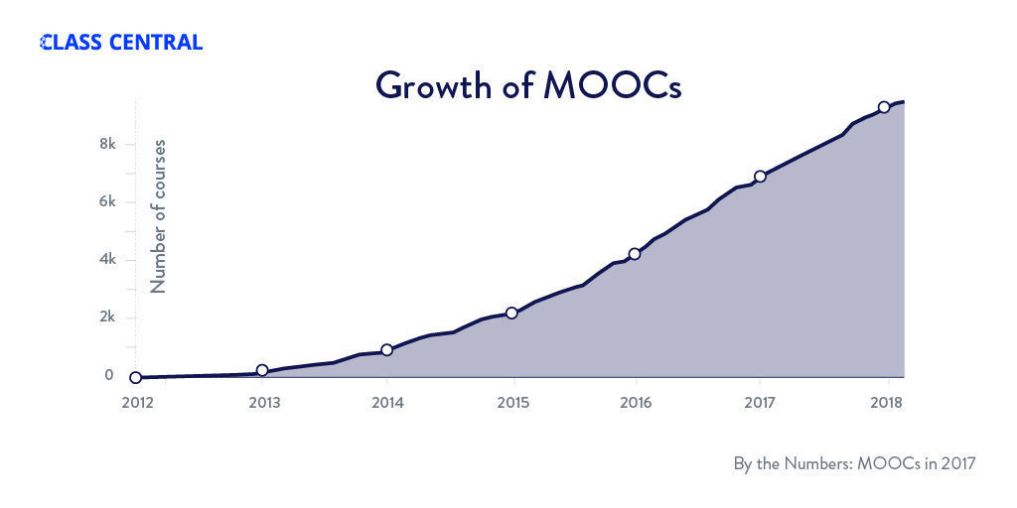
August 19, 2018
Cumulative Growth in Number of MOOCs, 2011-18
Almanac 2018, Chronicle of Higher Education https://www.chronicle.com/article/Top-5-MOOC-Providers-by-Number/244090?cid=cp216

Slide 9

MOOC Research Gaps and Summaries

Slide 10
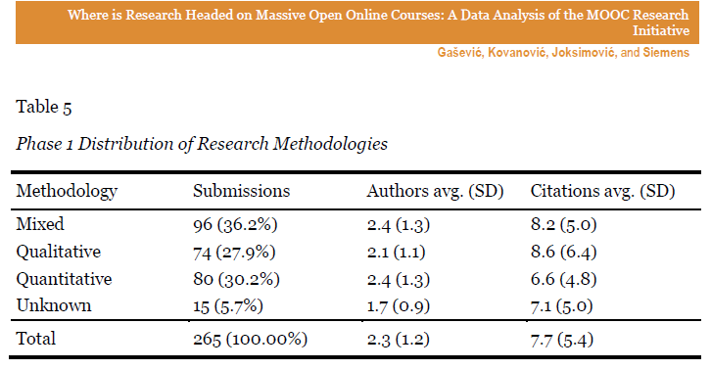
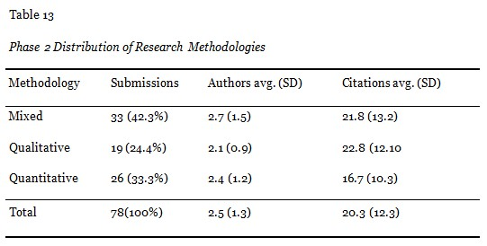
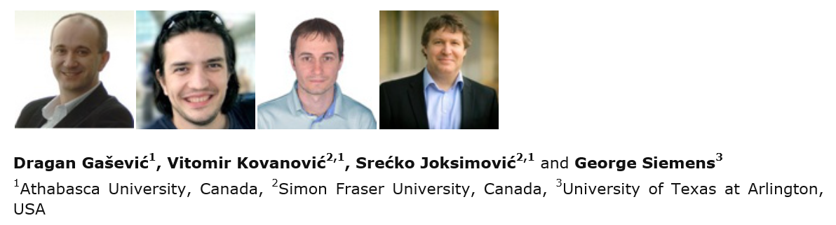
November 2014
Where is Research on Massive Open Online Courses Headed? A Data Analysis of the MOOC Research Initiative
Dragan Gasevic and colleagues (including George Siemens), IRRODL http://www.irrodl.org/index.php/irrodl/article/view/1954

Slide 11
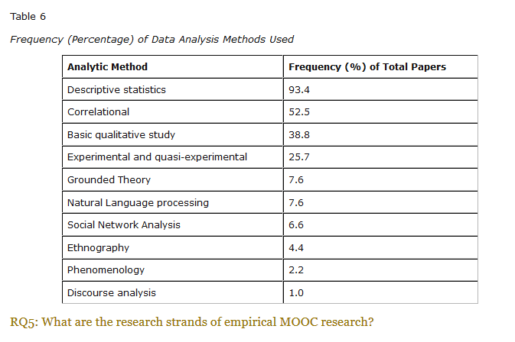
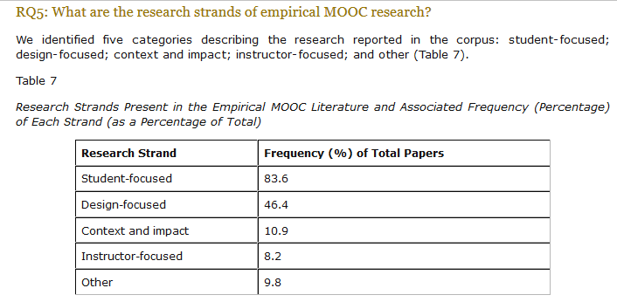

February 2016
A Systematic Analysis and Synthesis of the Empirical MOOC Literature Published in 2013-2015, IRRODL
George Veletsianos and Peter Sheperdson http://www.irrodl.org/index.php/irrodl/article/view/2448/3655

Slide 12
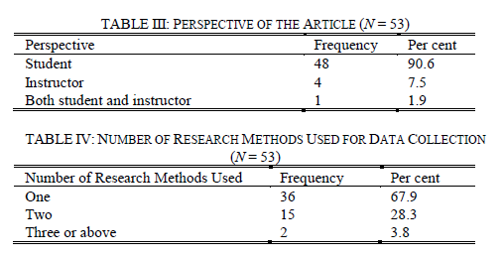
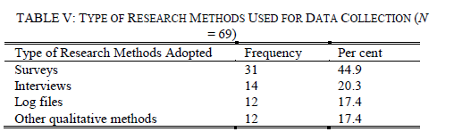


August 2017
A Contemporary Review of Research Methods Adopted to Understand Students’ and Instructors’ Use of Massive Open Online Courses (MOOCs)
Ruiqi Deng and Pierre Benckendorff
“Second, triangulation of a wider range of research methods and data source should be undertaken. Beyond triangulation of surveys and interviews or log files, MOOC scholars are encouraged to combine other research methods to triangulate findings, such as diary studies and focus groups.” (p. 605)

Slide 13
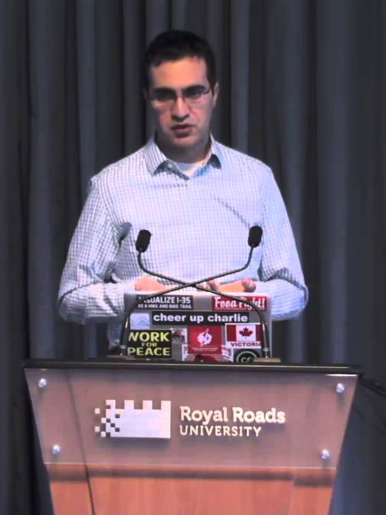
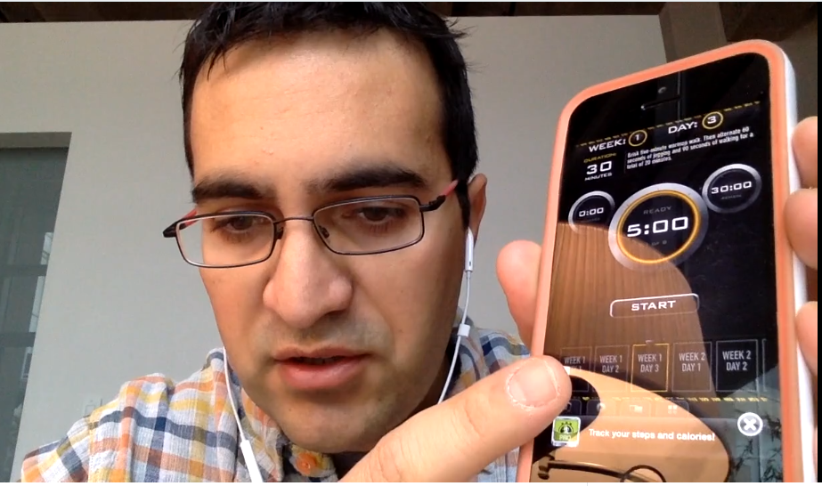

Quotes: Veletsianos et al. (2015-2016)
“To gain a deeper and more diverse understanding of the MOOC phenomenon, researchers need to use multiple research approaches (e.g., ethnography, phenomenology, discourse analysis) add content to them.” (p. 583)
Veletsianos, Collier, & Schneider (2015, May), Digging deeper into learners’ experiences in MOOCs: Participation in social networks outside of MOOCs, notetaking and contexts surrounding content consumption. BJET, 46(3), 570-587.
“Dependence on Particular Research Methods May Restrict our Understanding of MOOCs.”
George Veletsianos & Peter Shepherdson’s Study (2016). Systematic Analysis and Synthesis of the Empirical MOOC Literature Published in 2013-2015. IRRODL. http://www.irrodl.org/index.php/irrodl/article/view/2448/3655

Slide 14


Research Focus and Purpose

Slide 15

MOOC Study #1: MOOC Research
A Systematic Review of Research Methods and Topics of the Empirical MOOC Literature (2014-2016)
Zhu, M., Sari, A., & Lee, M. M. (2018). A Systematic Review of Research Methods and Topics of the Empirical MOOC Literature (2014-2016). The Internet and Higher Education. 37,31-39.

Slide 16
Research Purpose & Questions
To gain a deeper and more diverse understanding of the current MOOC phenomenon by reviewing recent articles.
1. What are the research methods researchers employed in empirical MOOC studies?
2. What are the research topics or focuses in MOOC studies?
3. How are researchers of empirical MOOC studies geographically distributed?
4. In terms of the delivery of the MOOC, what are the countries which are attracting the most research?

Slide 17
Article Search Strategies
Key words
“MOOC” and “Massive Online Open Course(s)”
Databases
Scopus and peer-reviewed journal articles
Phase 1
October 2014 - November 2016
(146 in total)
Phase 2
December 2016 - July 2017
(51 in total)

Slide 18
Systematic Review of Research Methods in MOOCs (2014-2016)
(Zhu, M., Sari, A., & Lee, M. M., 2018)
RQ1: What are the research methods researchers employed in empirical MOOC studies? (N = 146)

Slide 19
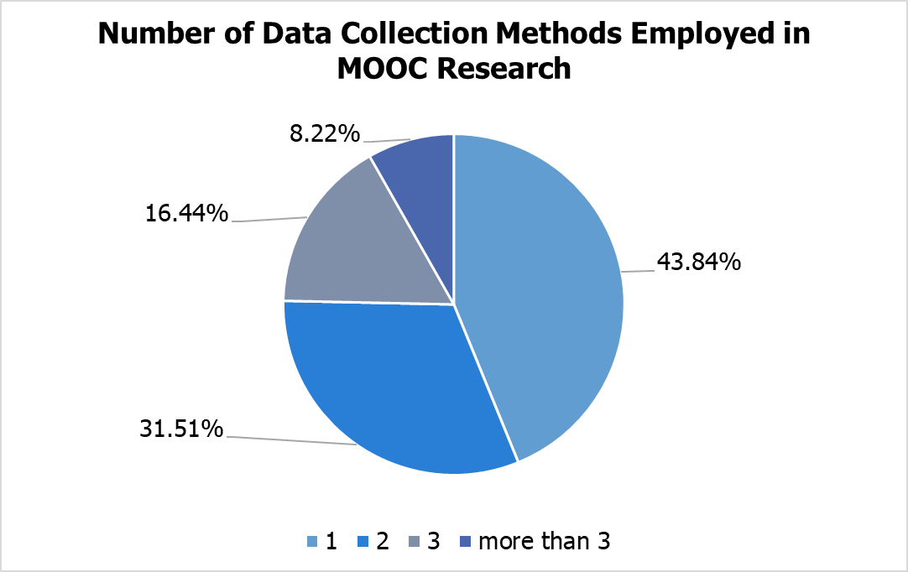
Number of Data Sources for MOOC Research
(2014-2016)
(Zhu, M., Sari, A., & Lee, M. M., 2018)
RQ1: What are the research methods researchers employed in empirical MOOC studies?
NUMBER OF DATA SOURCES | TOTAL | PERCENT
1 | 64 | 43.84%
2 | 46 | 31.51%
3 | 24 | 16.44%
>3 | 12 | 8.22%
TOTAL STUDIES | 146 | 100%

Slide 20
Systematic Review of Research Methods in MOOCs (2014-2016)
(Zhu, M., Sari, A., & Lee, M. M., 2018)
Primary/general focus of MOOC delivery (out of 146 studies)
(note: some studies have more than one area of focus)

Slide 21
Systematic Review of Research Methods in MOOCs (2014-2016)
(Zhu, M., Sari, A., & Lee, M. M., 2018)
 | Quantitative | Qualitative | Mixed methods
Student-focused | 39 | 9 | 26
Design-focused | 19 | 12 | 17
Context and impact | 9 | 6 | 5
Instructor-focused | 0 | 3 | 2

Slide 22
Systematic Review of Research Methods in MOOCs (2014-2016)
(Zhu, M., Sari, A., & Lee, M. M., 2018)
No. | Journal | Total
1 | International Review of Research in Open and Distance Learning (IRRODL) | 31
2 | Computers & Education | 12
3 | British Journal of Educational Technology | 9
4 | Online Learning | 7
5 | Distance Education | 5
6 | Educational Media International | 5
7 | Internet and Higher Education | 5
8 | Journal of Computer Assisted Learning | 5
9 | Computers in Human Behavior | 4
10 | Open Learning | 4
11 | Journal of Online Learning and Teaching | 3
12 | Journal of Asynchronous Learning Network | 3

Slide 23
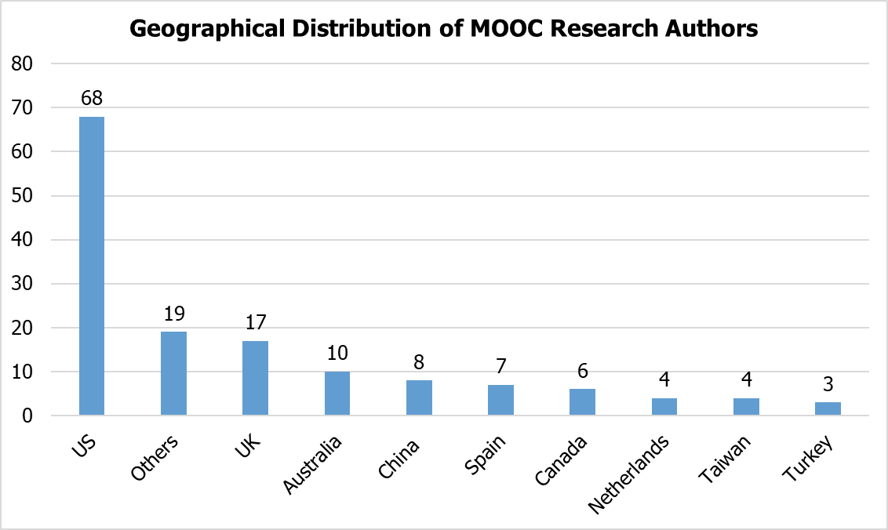
Findings (Zhu, M., Sari, A., & Lee, M. M., 2018)
RQ3: How are researchers of empirical MOOC studies geographically distributed?

Slide 24
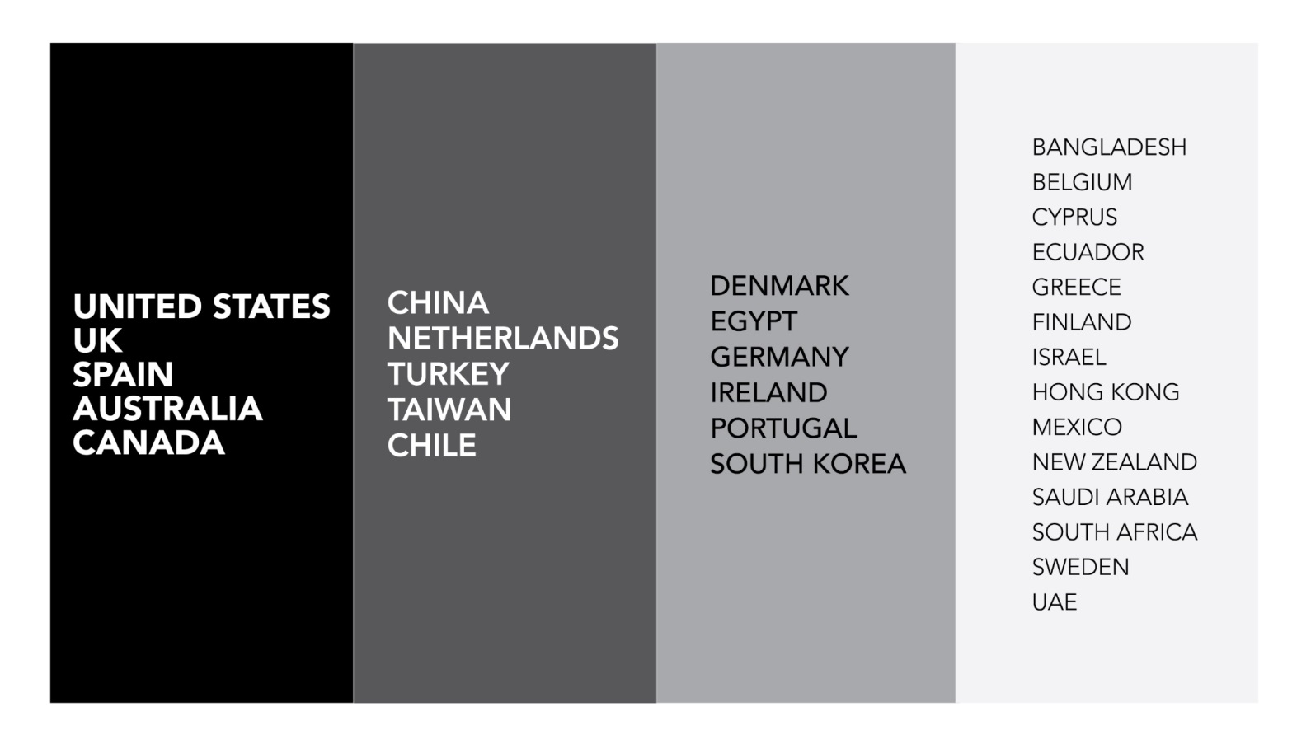
Systematic Review of Research Methods in MOOCs (2014-2016)
(Zhu, M., Sari, A., & Lee, M. M., 2018)
Location of MOOC Research Team Members (2014-2016)

Slide 25
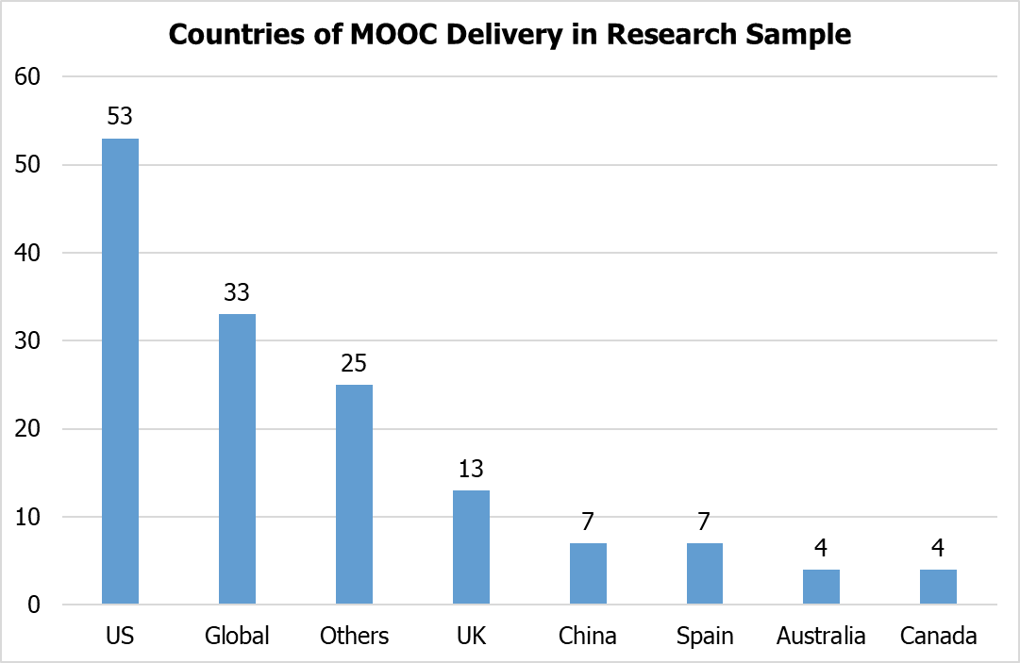
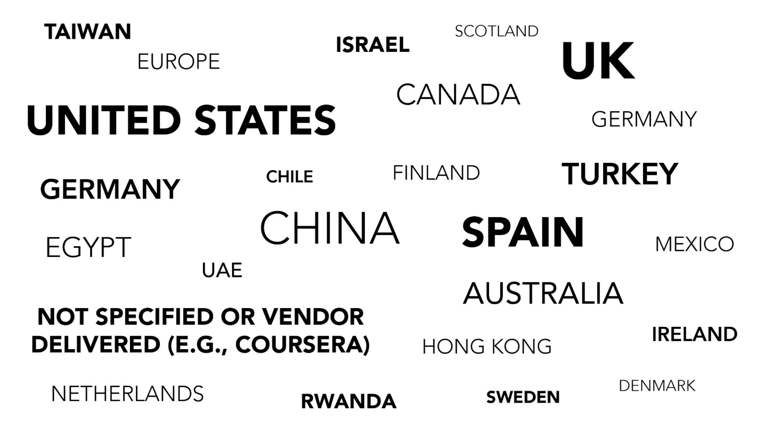
Findings (Zhu, M., Sari, A., & Lee, M. M., 2018)

Slide 26
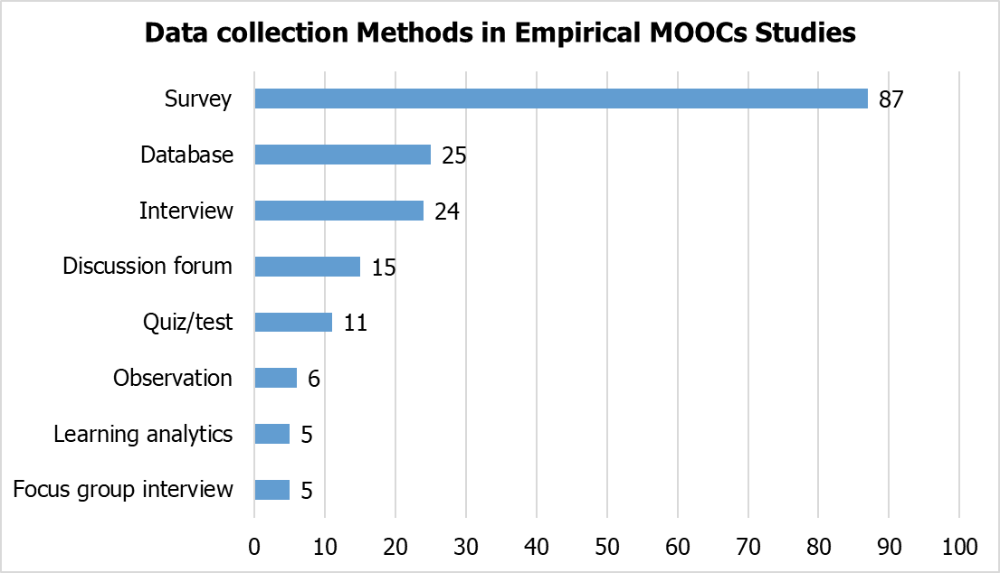
Systematic Review of Research Methods in MOOCs (2014-2016)
(Zhu, M., Sari, A., & Lee, M. M., 2018)
RQ1: What are the research methods researchers employed in empirical MOOC studies?

Slide 27

Specific Data Sources for MOOC Research
(2014-2016)
(Zhu, M., Sari, A., & Lee, M. M., 2018)

Slide 28
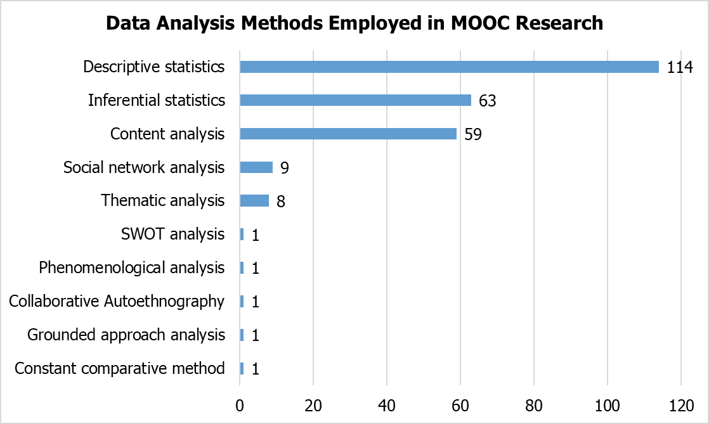
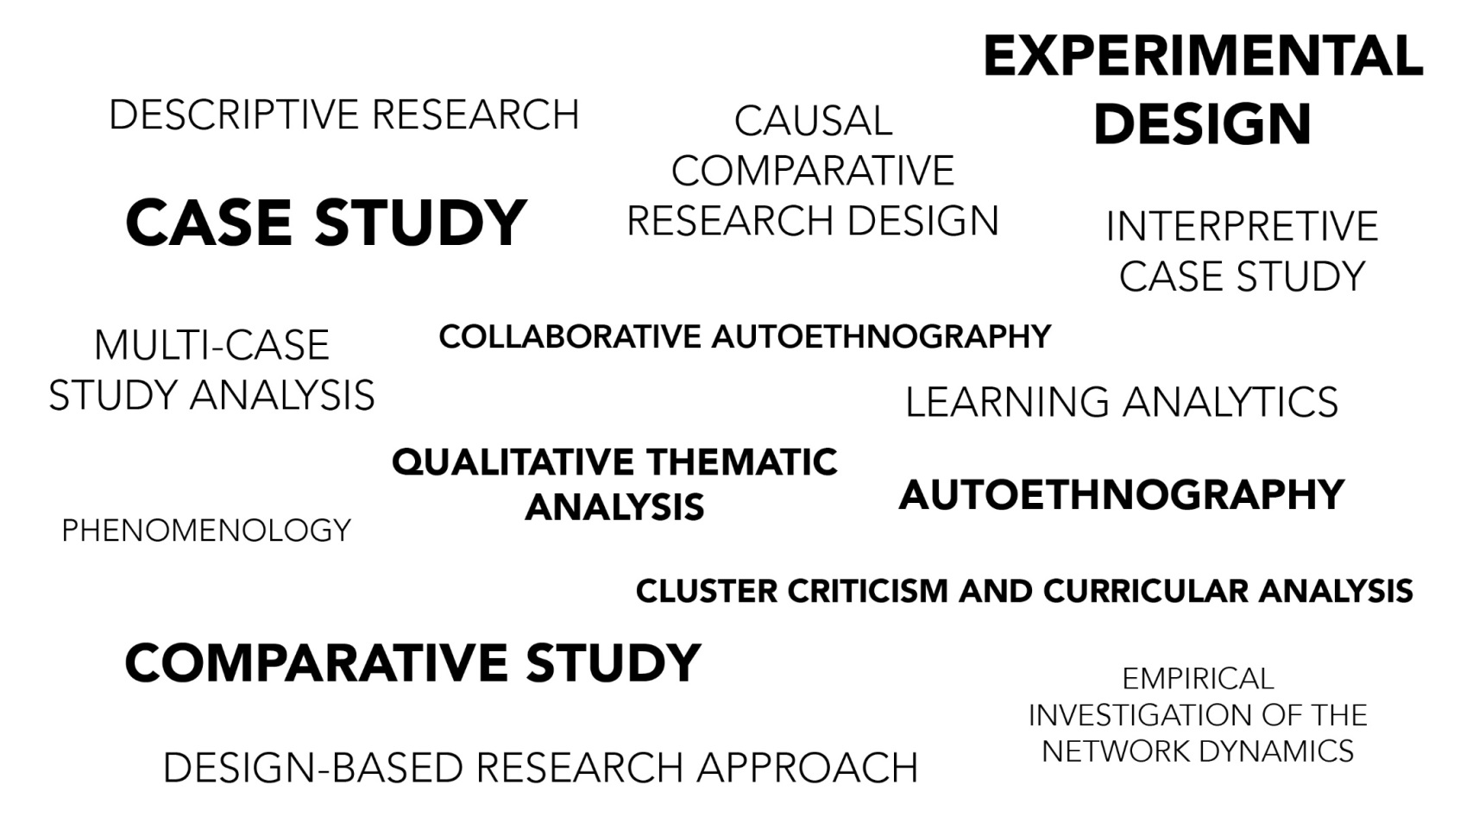
Systematic Review of Research Methods in MOOCs (2014-2016)
(Zhu, M., Sari, A., & Lee, M. M., 2018)
RQ1: What are the research methods researchers employed in empirical MOOC studies?

Slide 29
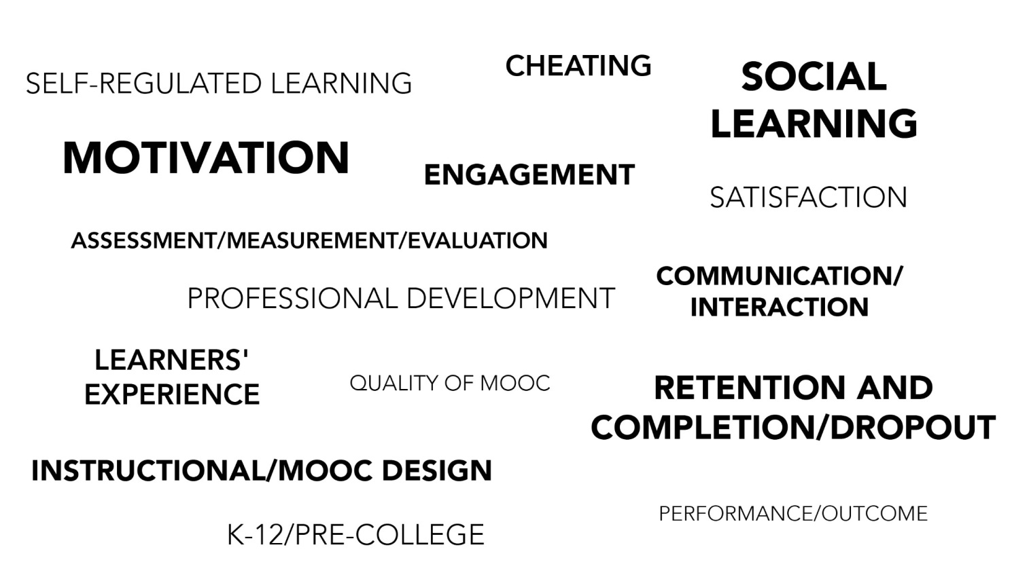
Systematic Review of Research Methods in MOOCs (2014-2016)
(Zhu, M., Sari, A., & Lee, M. M., 2018)
Specific Focus of MOOC Research (2014-2016)

Slide 30


Phase #2:
The Study Expanded

Slide 31
MOOC Study #2: MOOC Research
A Systematic Review of MOOC Research Methods and Topics:
Comparing 2014-2016 and 2016-2017
Zhu, M., Sari, A., & Bonk, C. J. (2018). Presented at Ed Media Amsterdam.

Slide 32
Systematic Review of Research Methods and
Topics in MOOCs:
Comparing 2014-2016 and 2016-2017
(Zhu, M., Sari, A., & Bonk, C. J., 2018)
Figure 1a. Research methods used in empirical MOOCs studies (2016 – 2017) (n=51)

Slide 33
Systematic Review of Research Methods and Topics in MOOCs:
Comparing 2014-2016 and 2016-2017
(Zhu, M., Sari, A., & Bonk, C. J., 2018)
Figure 1b. Research methods used in empirical MOOCs studies (Note: Phase One (2014 – 2016) (n=146); Phase Two (2016 – 2017) (n=51))

Slide 34
Systematic Review of Research Methods and Topics in MOOCs:
Comparing 2014-2016 and 2016-2017
(Zhu, M., Sari, A., & Bonk, C. J., 2018)
Figure 2a. Data collection methods used in empirical MOOCs studies (2016 – 2017) (n=51) (Note: some studies contain more than one data collection method)

Slide 35
Systematic Review of Research Methods and Topics in MOOCs:
Comparing 2014-2016 and 2016-2017
(Zhu, M., Sari, A., & Bonk, C. J., 2018)
Figure 2b. Data collection methods used in empirical MOOCs studies (Note: some studies contain more than one data collection method and this figure only includes the main data collection methods)

Slide 36
Systematic Review of Research Methods and Topics in MOOCs:
Comparing 2014-2016 and 2016-2017
(Zhu, M., Sari, A., & Bonk, C. J., 2018)
Figure 3a. Specific data analysis methods for MOOC research (2014-2016 and 2016 – 2017)

Slide 37
Systematic Review of Research Methods and Topics in MOOCs:
Comparing 2014-2016 and 2016-2017
(Zhu, M., Sari, A., & Bonk, C. J., 2018)
Figure 3b. Specific data analysis methods for MOOC research (Note: some studies contain more than one data analysis method)

Slide 38

Systematic Review of Research Methods and Topics in MOOCs:
Comparing 2014-2016 and 2016-2017
(Zhu, M., Sari, A., & Bonk, C. J., 2018)

Slide 39
Systematic Review of Research Methods and Topics in MOOCs:
Comparing 2014-2016 and 2016-2017
(Zhu, M., Sari, A., & Bonk, C. J., 2018)
Figure 4a. Primary/general focus of MOOC delivery (2016 – 2017) (n=51) (Note: some studies contain more than one area of focus)

Slide 40
Systematic Review of Research Methods and Topics in MOOCs:
Comparing 2014-2016 and 2016-2017
(Zhu, M., Sari, A., & Bonk, C. J., 2018)
Figure 4b. Primary/general focus of MOOC delivery (Note: some studies contain more than one area of focus)

Slide 41
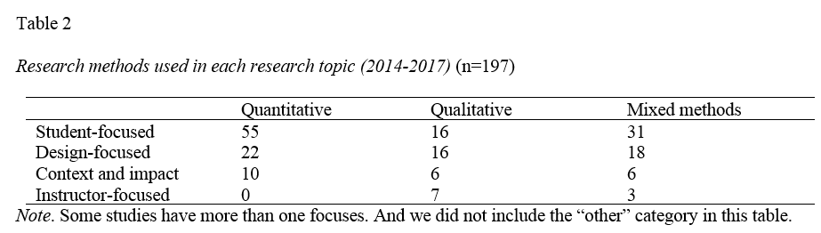
Systematic Review of Research Methods and Topics in MOOCs:
Comparing 2014-2016 and 2016-2017
(Zhu, M., Sari, A., & Bonk, C. J., 2018)

Slide 42
Systematic Review of Research Methods and Topics in MOOCs:
Comparing 2014-2016 and 2016-2017
(Zhu, M., Sari, A., & Bonk, C. J., 2018)
Figure 5. The location of the first author of MOOCs studies (2014 – 2017) (n=197) (Note: this figure only includes the main countries)

Slide 43
Systematic Review of Research Methods and Topics in MOOCs:
Comparing 2014-2016 and 2016-2017
(Zhu, M., Sari, A., & Bonk, C. J., 2018)
Figure 6. Collaboration among the authors of MOOCs studies (2016 – 2017) (n=51)

Slide 44
Systematic Review of Research Methods and Topics in MOOCs:
Comparing 2014-2016 and 2016-2017
(Zhu, M., Sari, A., & Bonk, C. J., 2018)
Figure 7. Countries of MOOC delivery in which the research was conducted (2014 – 2017) (n=197) (Note: this figure only includes the main countries)

Slide 45

Phase 3:The Study has expanded again!

Slide 46
Journals that published empirical MOOC studies (2013-2018)
Figure 1. Number of empirical MOOC studies annually published in different journals from 2013-2018 (N=321 studies)

Slide 47
Total Number of Empirical MOOC Studies Published in Different Journals from 2013-2018
Table 1
(Note: the table only includes the top nine journals in terms of the number of empirical MOOC studies)
Journals | Number of empirical studies
International Review of Research in Open and Distributed Learning | 51
Computers & Education | 22
British Journal of Educational Technology | 15
Online Learning | 12
Distance Education | 11
Journal of Online Learning and Teaching | 11
The Internet and Higher Education | 10
Computers in Human Behavior | 10
Open Learning | 8

Slide 48
Research methods used in empirical MOOCs studies
Figure 2. Research methods used in empirical MOOCs studies from 2013-2018 (N=321 studies)

Slide 49
Types of MOOC research methods used in different countries
Figure 3. Types of MOOC research methods used in the five countries with the most MOOC research from 2013-2018 (N=321 studies)

Slide 50
Types of MOOC research methods used by year (2013-2018)
Figure 4. Types of MOOC research methods used in each year from 2013-2018 (N=321 studies)

Slide 51
Data collection methods used in empirical MOOCs studies
Figure 5. Data collection methods used in empirical MOOCs studies from 2013-2018 (N = 321 studies)
(Note: some studies contain more than one data collection method and this figure only includes the main data collection methods)

Slide 52

Tired of MOOCs…?

Slide 53

If not, you might read…

Slide 54


Curtis J. Bonk, IU, cjbonk@indiana.edu
Meina Zhu, IU, meinzhu@iu.edu
Annisa Sari, IU, annsari@iu.edu

